Slide 1
CAPSTONE PROJECT ON SUPERMARKET SALES
ANALYSIS AND RECOMMENDATIONS
BY
AGBOTOBA OMOLOLU
16TH OF JUNE, 2024

Slide 2
PROJECT STATEMENT
The supermarket lacks understating about its customer purchasing pattern, city with the most revenue and product that it needs to increase at its branches so as to increase profit and better customer satisfaction.

Slide 3
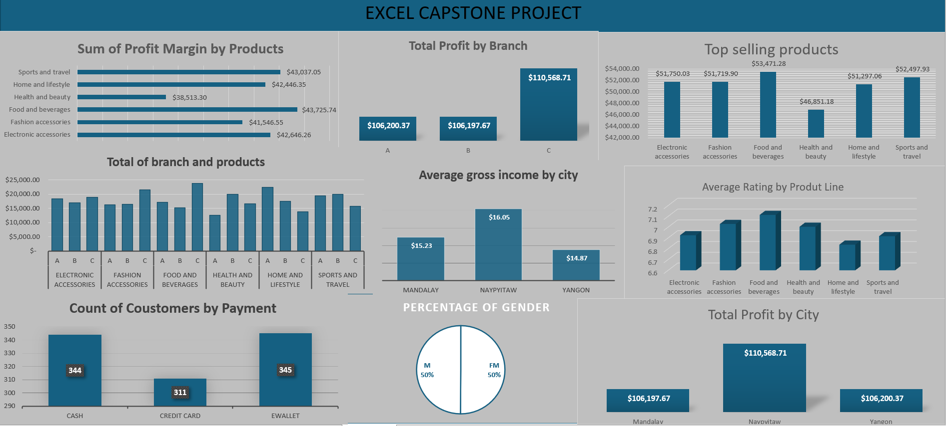
DASHBOARD OVERVIEW

Slide 4
Data Cleaning
Checked for misspellings and missing vales to ensure I present a clean and analyzed data.
Ensured the proper currency was used and the data types are in there columns.

Slide 5
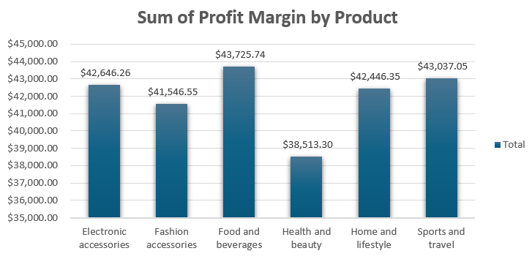
PROFIT MARGIN BY PRODUCTS
Profit made from all products.
Food and beverage makes the most.

Slide 6
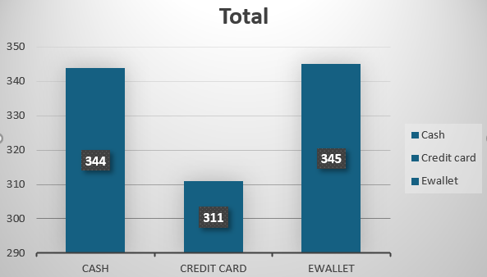
PAYMENT METHODS
It is used to determine the method used by customers for payment.
Distribution of payment methods.

Slide 7
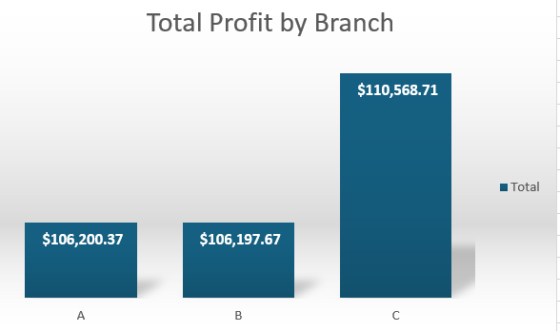
PERFORMANCE ANALYSIS BY BRANCH
Total sales by branch.
It shows that branch ‘C’ has the highest sales.

Slide 8
KEY FINDINGS
The branch with the most profit is branch C
The most popular form of payment is Ewallet
Top selling product is food and beverage
The city with the most average gross income is Naypyitaw

Slide 9
RECOMMENDATIONS AND CONCLUSION
There is need to constantly review and analyze their sales performance to identify areas that needs improvement
Market location and products should be at prioritized at every city and branch
Promote top product line
Implement targeted campaigns based on purchasing behavior

Slide 10
THANK YOU

